Slide 1
Empathetic Dialogues Classification
Nitin Gupta, Akina Kuperus, Taimoor Shahzad, Riya Shrestha, Abdul-Wahid Yakubu

Slide 2

What is empathy?
Empathy is the ability to understand and share the feelings of others.
Problem:
Comparing traditional ML and deep learning techniques to build a text-based emotion/empathy classifier.
Goal:
To evaluate the effectiveness traditional ML vs. deep learning in emotion analysis

Slide 3
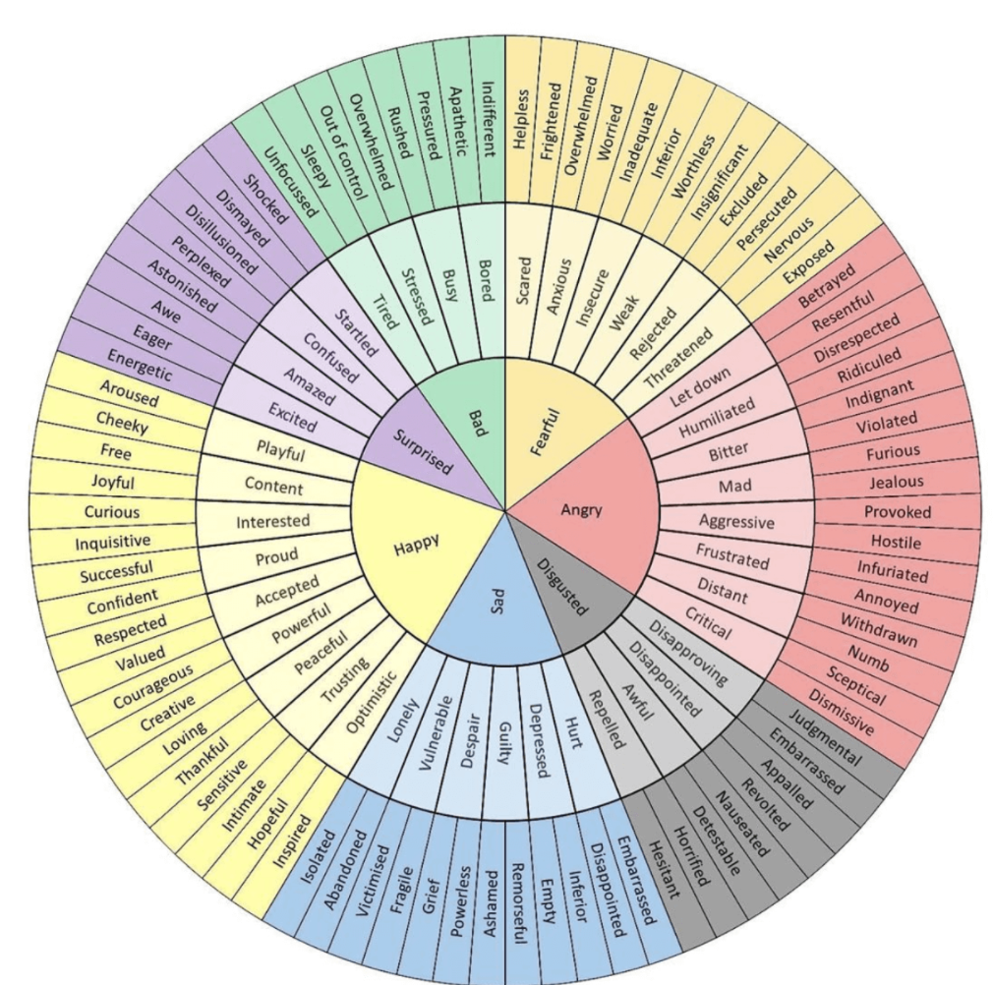
Advancements in NLP:
Models like BERT excel at understanding but require fine-tuning to effectively capture emotional context.
EmpatheticDialogues Dataset: 25,000 empathetic conversations to train AI on recognizing emotion in text.
Goal:
Develop a machine learning and a deep learning model to classify the emotion of conversations in EmpatheticDialogues.

Slide 4
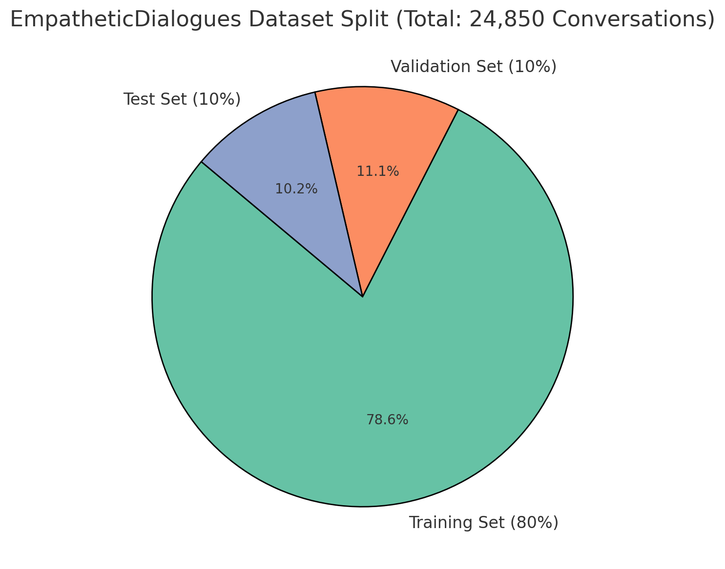
Dataset
EmpatheticDialogues is a dataset designed to train models to recognize, understand, and respond appropriately to human emotions in conversations.
Dataset Overview:
  Total conversations: 24,850
  Total Participants: 810 (Amazon MTurk)
Dataset Split:
  Training set: 19,533 conversations (~78%)
  Validation set: 2,770 conversations (~11%)
  Test set: 2,547 conversations (~10%)

Slide 5
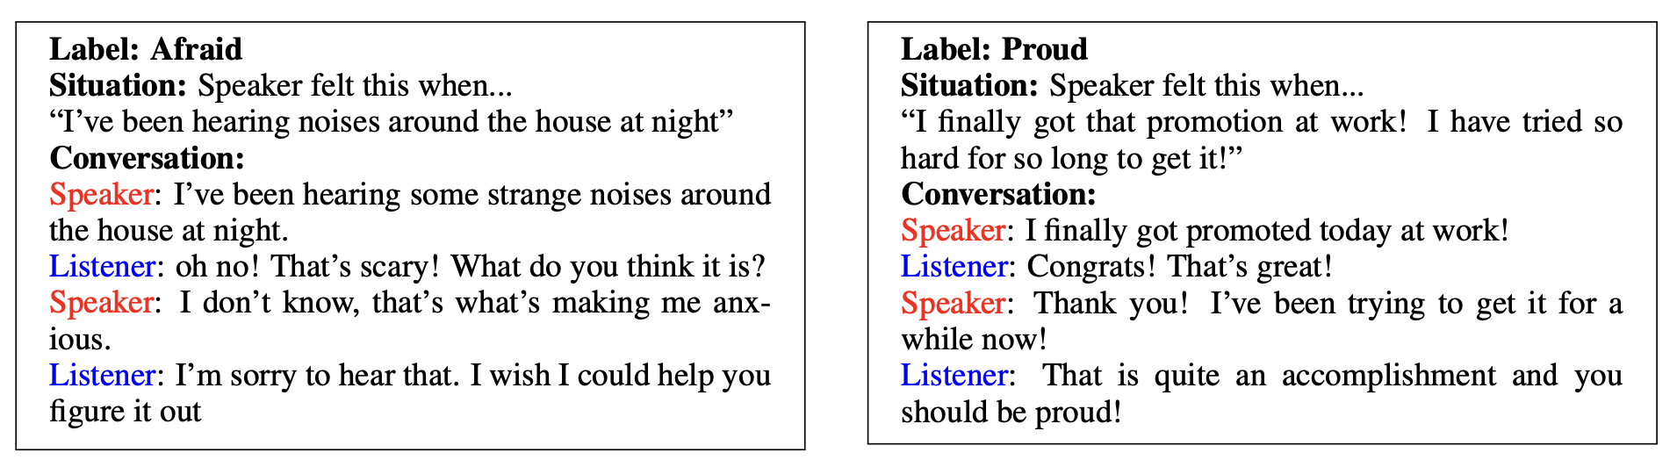
Dataset and Labels
Each conversation has a Speaker (who shares an emotional situation) and a Listener (who responds empathetically).

Slide 6
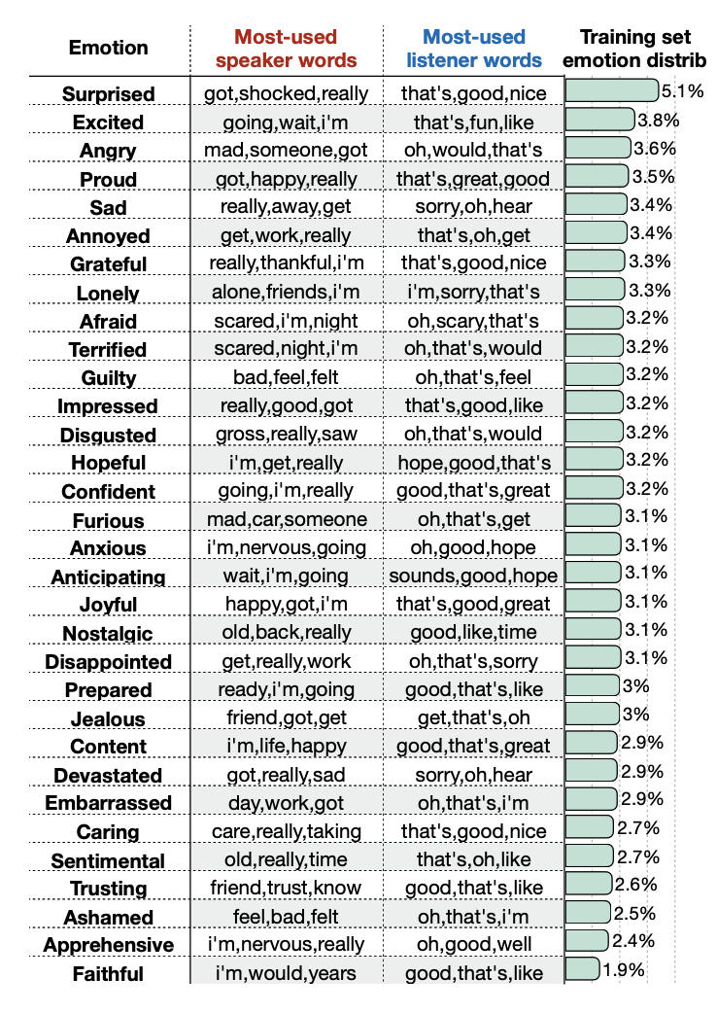
Dataset and Labels
Includes 32 emotion labels.
Displays frequency of different emotions in dataset.
Highlights most-used words by Speaker and Listener for each emotion.

Slide 7
Preprocessing Steps - Combining conversations
Combined Conversation (Speaker + Listener) | Label
“I've been hearing some strange noises around the house at night. Oh no! That's scary! What do you think it is? I don't know, that's what's making me anxious. I'm sorry to hear that. I wish I could help you figure it out.” | Afraid
“I finally got promoted today at work! Congrats! That’s great! Thank you! I’ve been trying to get it for a while now! That is quite an accomplishment and you should be proud! | Proud

Slide 8
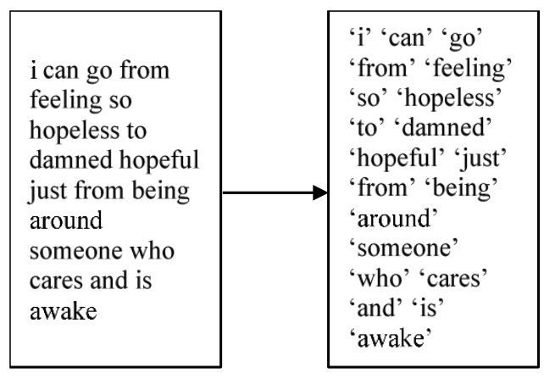
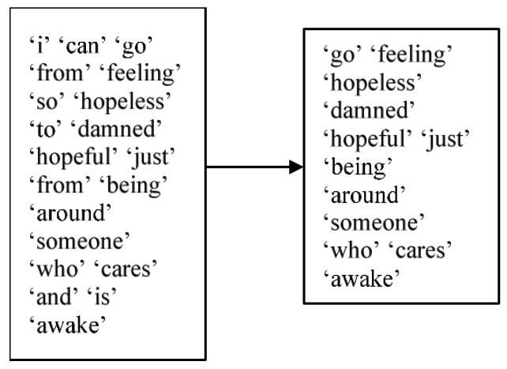
Preprocessing Steps - Tokenization & Stopword Removal
Tokenization
Stopword Removal
Dataset
Notes:
Initial preprocessing
Combining conversations
Stopword removal
TF-IDF
Traditional models we tried
Random Forests
Logistic Regression
SVM
Further preprocessing
Emotion mapping
Angry and annoyed are similar (give examples)
Share heatmap

Slide 9
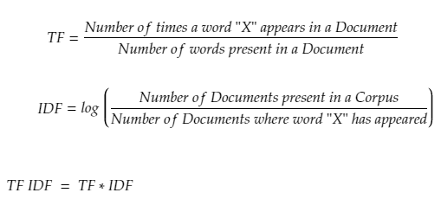
Preprocessing Steps - TF-IDF
TF-IDF (Term Frequency-Inverse Document Frequency) measures how important a word is in a document relative to a collection of documents. It helps to identify key terms by reducing the weight of common words.
Notes:
Initial preprocessing
Combining conversations
Stopword removal
TF-IDF
Traditional models we tried
Random Forests
Logistic Regression
SVM
Further preprocessing
Emotion mapping
Angry and annoyed are similar (give examples)
Share heatmap

Slide 10
Classification using Traditional Models
Model | Training error | Validation Error
Linear SVM | 0.7986 | 0.8125
Logistic regression | 0.3222 | 0.5548
Random Forest | 0.3868 | 0.6609
Naive Bayes | 0.1125 | 0.5802
Decision Tree | 0.0 | 0.7505

Slide 11
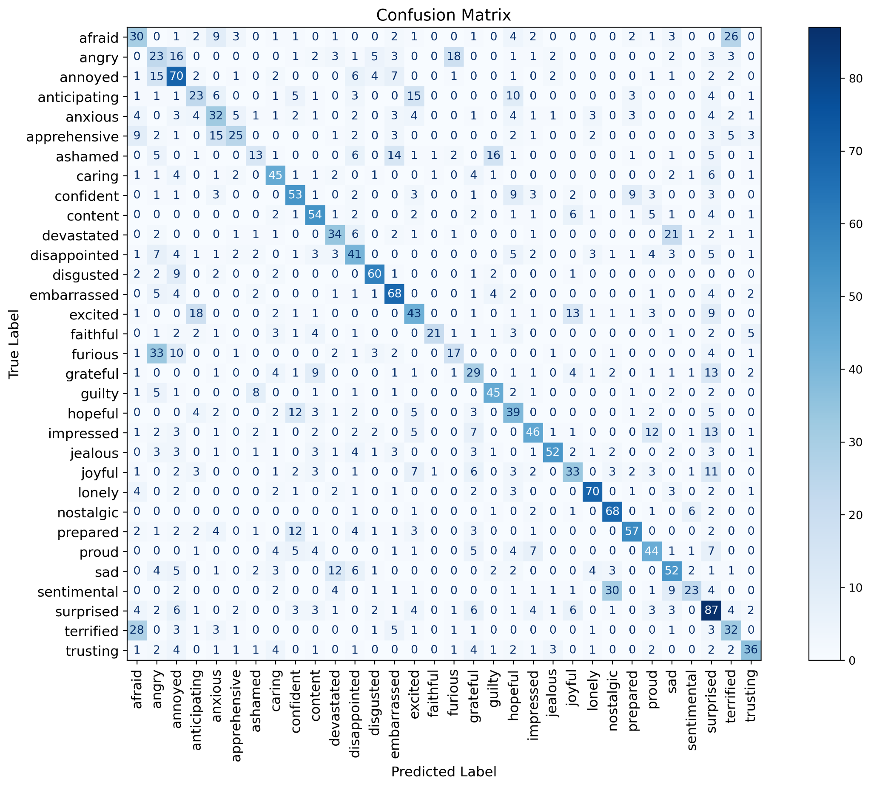
Confusion Matrix using SVM - Validation Set

Slide 12
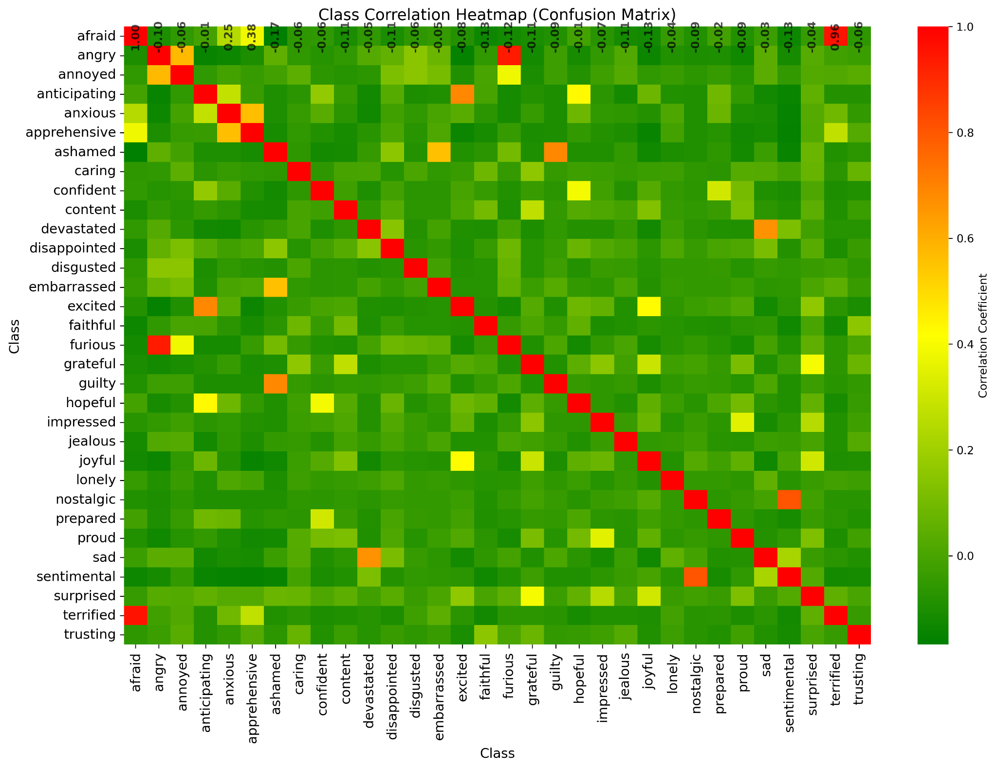
Class Correlation Heat Map

Slide 13
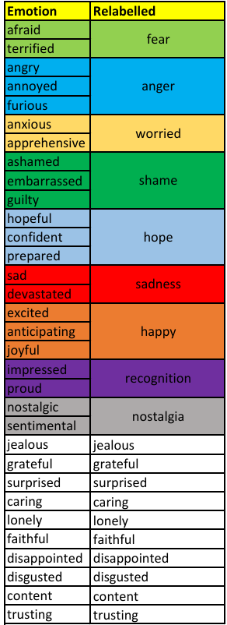
Emotions Mapping Scheme
Notes:
Original 32 labels to 19 labels at the end after we put together the strongest correlation classes together

Slide 14
Hierarchical Model
Positive
Negative

Slide 15
Hierarchical Model
Happy
Sad
Reflective
Angry

Slide 16
Hierarchical Model
Surprised
Hope
Shame
Worried
Happy
Sadness
Content
Grateful
Disappointed
Lonely
Faithful
Caring
Anger
Fear
Nostalgia
Recognition
Trusting
Disgust
Jealousy

Slide 17
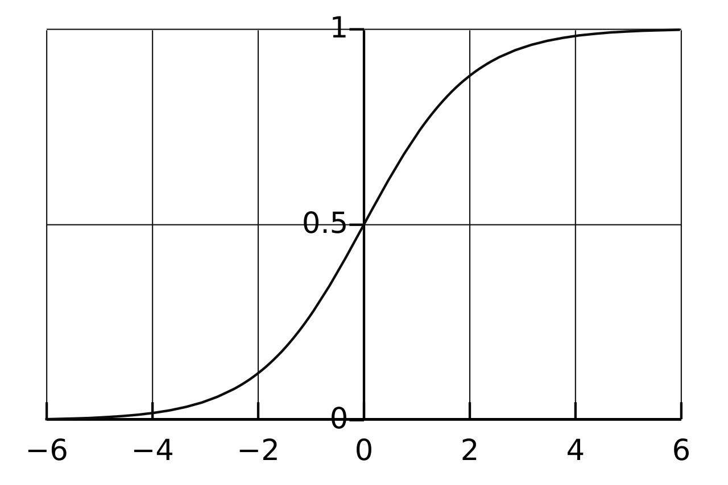
TF-IDF
Positive
Negative
Happy
Reflective
Angry
Sad
Surprised, Hope, Happy, Content, Grateful
Faithful, Caring, Nostalgia, Recognition, Trusting
Anger, Fear, Disgust, Jealousy
Shame, Worry, Sadness, Disappointed, Lonely

Slide 18
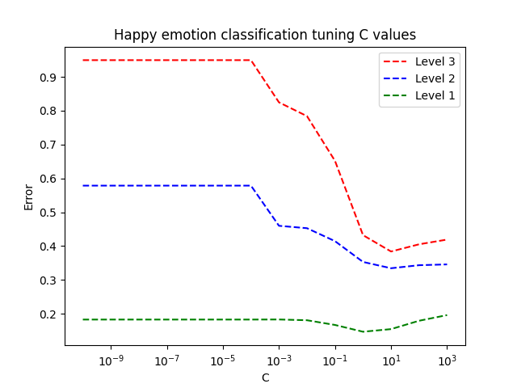
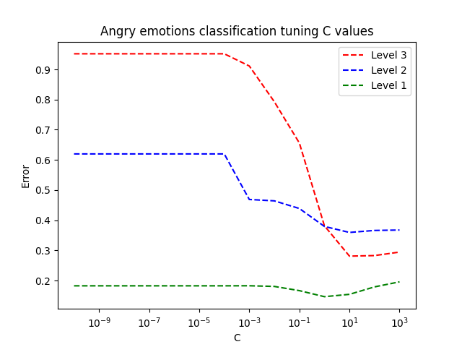
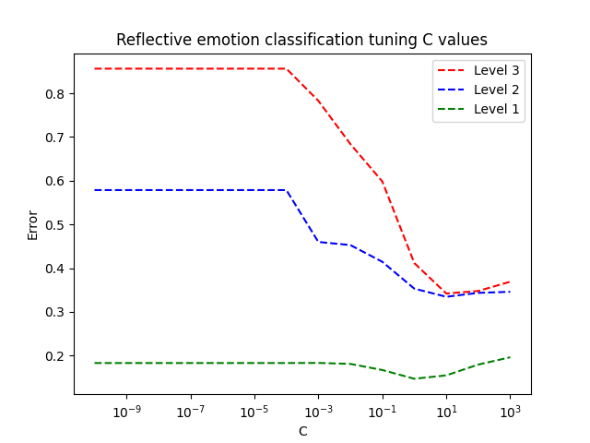
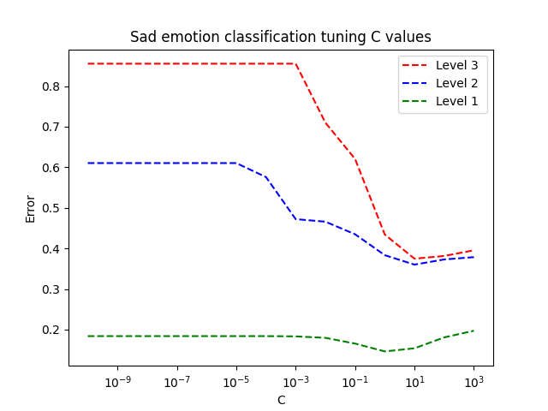
As classification becomes finer, the regularization strength decreases.
*In scikit-learn logistic regression, smaller C values induce stronger regularization.

Slide 19
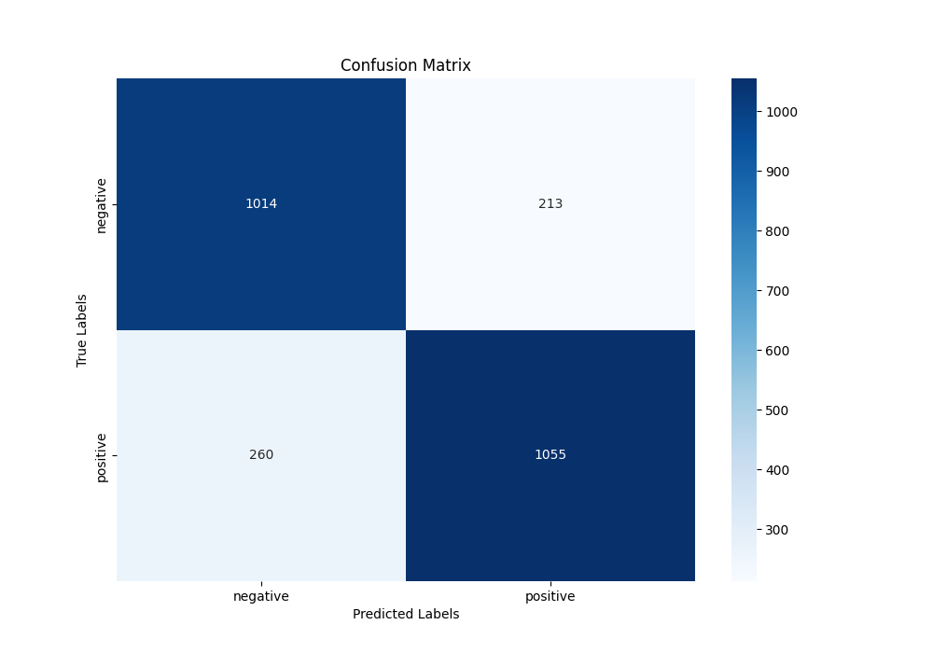
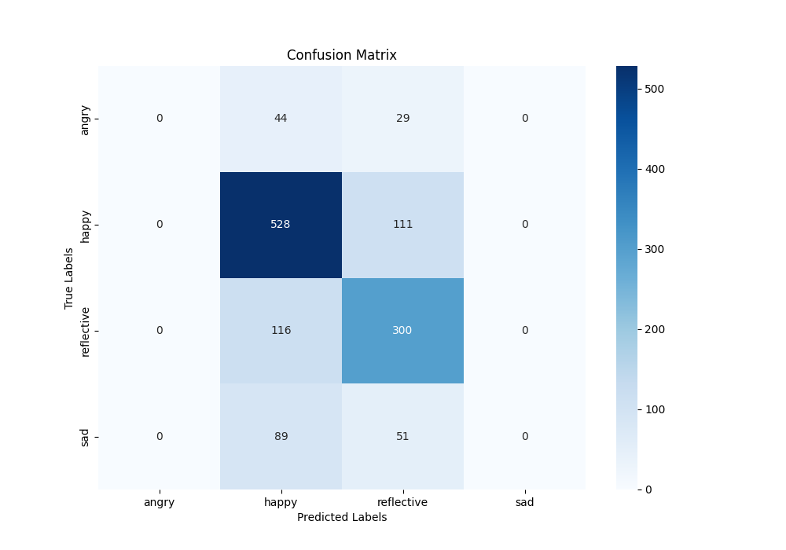
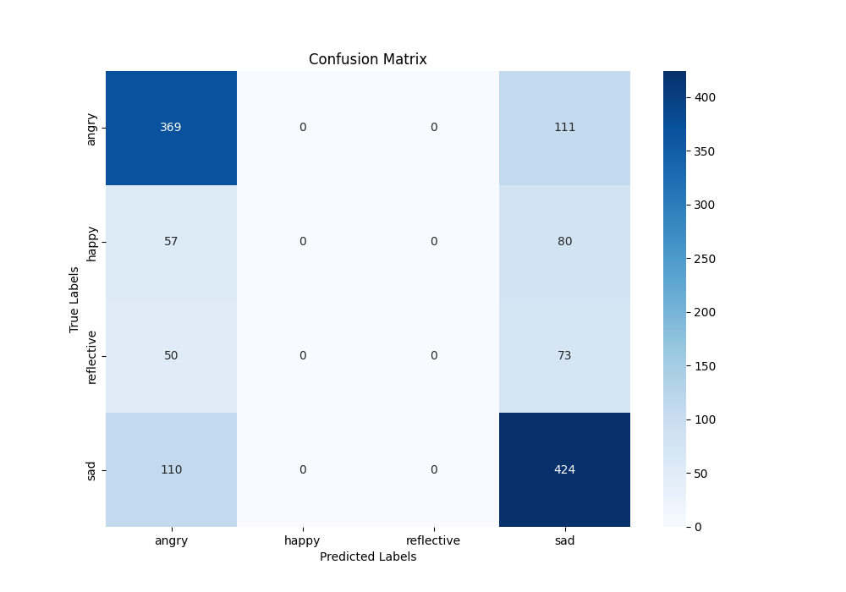

Slide 20
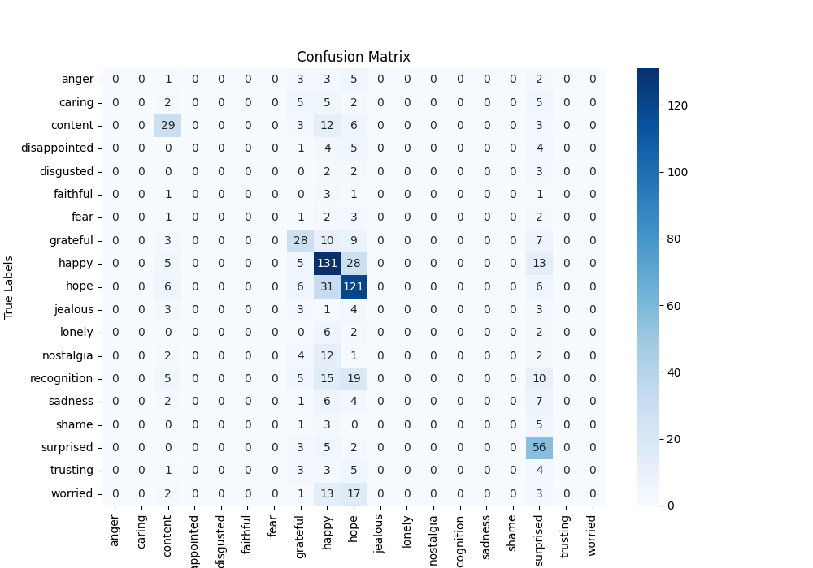
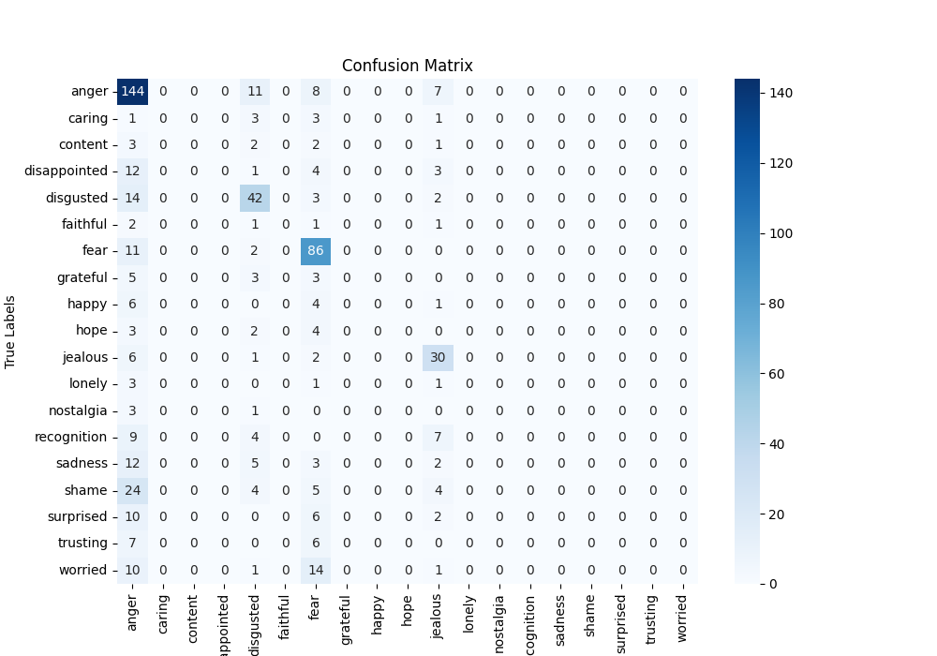


Happy Classification
Angry Classification
Reflective Classification
Sad Classification

Slide 21
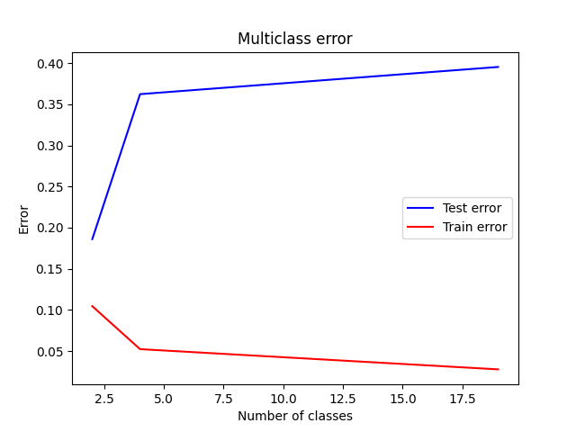
Error increases as the number of classes increases.
Final Error:
0.3954 ± 0.0190
*Random classification would have an error of .9474
Notes:
As the number of classes increases, learning becomes more difficult
For the final classification of 19 emotions
Note that random classification would have an error of .9474

Slide 22
BERT - Bidirectional Encoder Representations from Transformers
BERT is a deep learning model developed by Google that excels in natural language understanding (NLU) tasks like text classification, question answering, and text generation.
Unlike previous models that process text from left to right (e.g., GPT) or right to left, BERT reads the entire sentence at once, learning context from both directions.
Pre-trained on large datasets (like Wikipedia & BooksCorpus) and then fine-tuned on specific tasks like sentiment analysis or text classification.

Slide 23
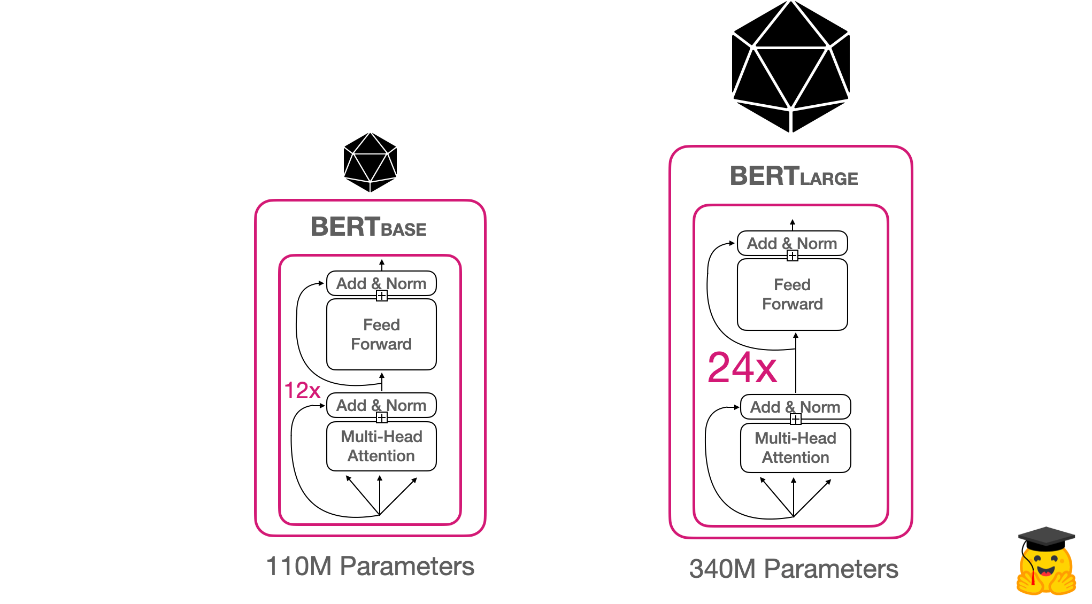
BERT - Base vs Large LLM
Source: https://huggingface.co/blog/bert-101

Slide 24
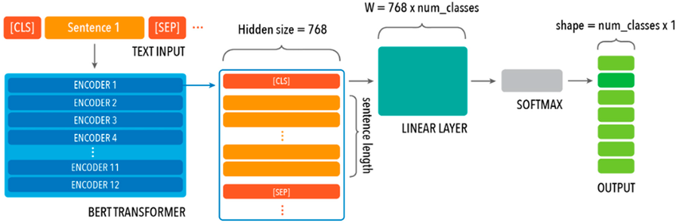
BERT Base - Architecture
Source: https://www.researchgate.net/figure/BERT-base-uncased-model-architecture-which-comprises-12-transformer-block-layers-each_fig2_374608193

Slide 25
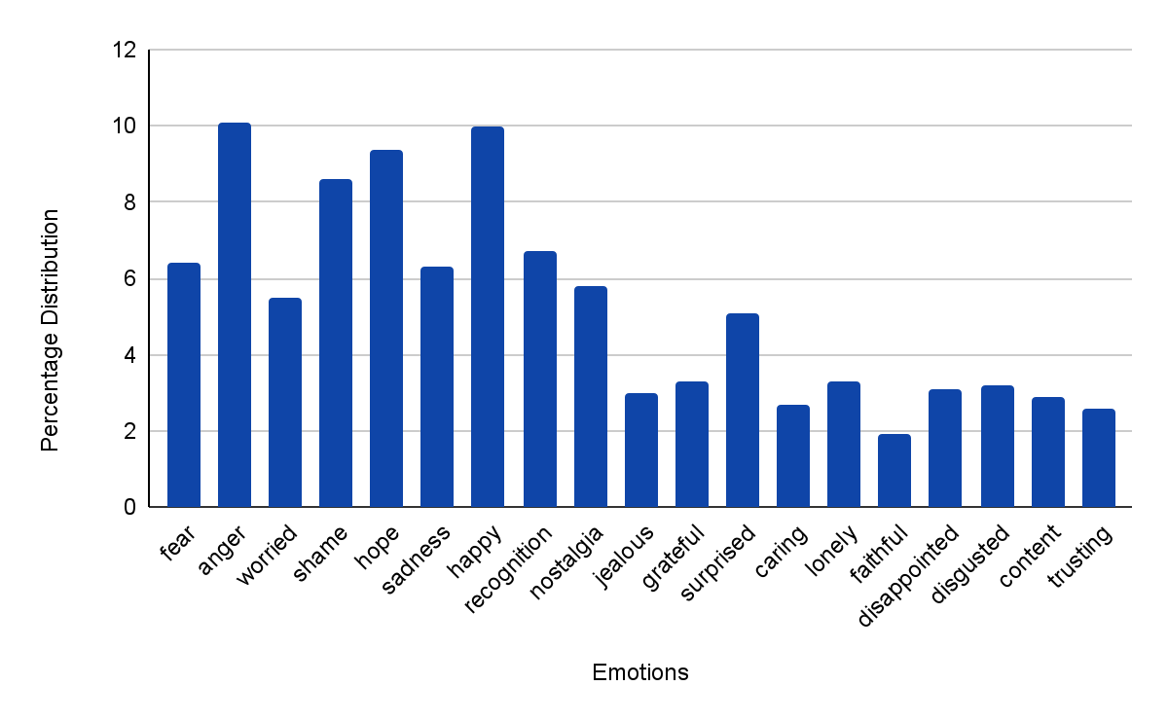
Emotions Mapping - BERT

Slide 26
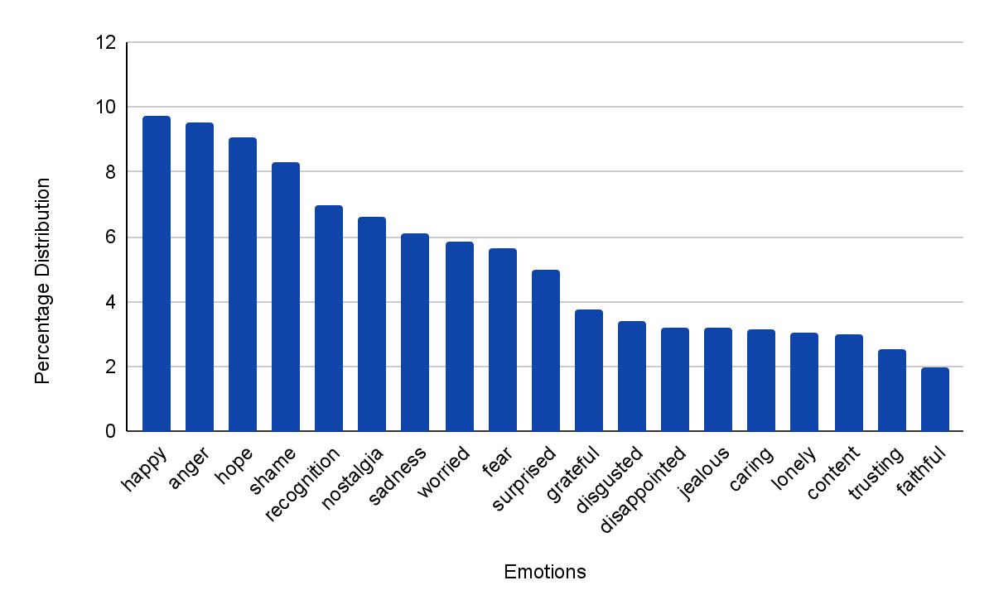
Emotions Mapping - BERT

Slide 27
BERT - Model Training
Component | Purpose
AdamW Optimizer | Optimizes BERT while reducing weight decay bias.
CrossEntropyLoss | Computes classification loss.
Mixed Precision (FP16) | Speeds up training & reduces memory usage.
Gradient Accumulation | Allows large batch training on limited memory.
Cosine Annealing LR Scheduler | Smoothly adjusts learning rate to prevent sharp changes.
Validation | Evaluates model performance after each epoch.

Slide 28
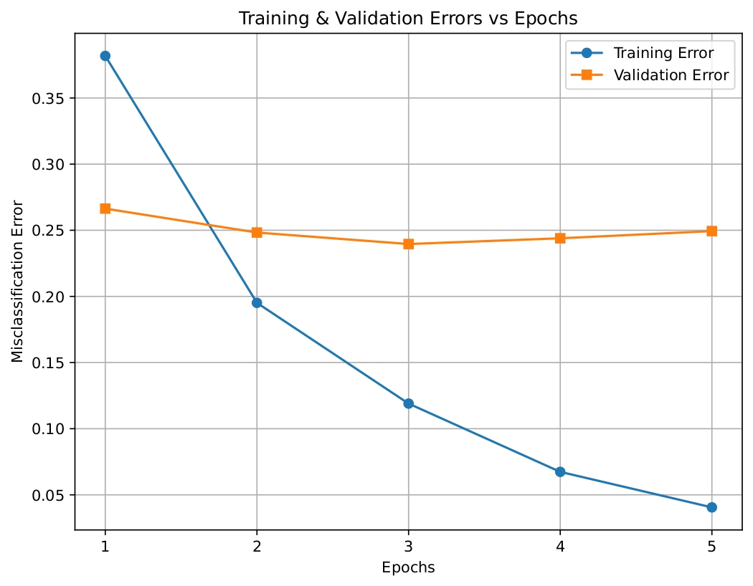
Results - Training vs Validation Error

Slide 29
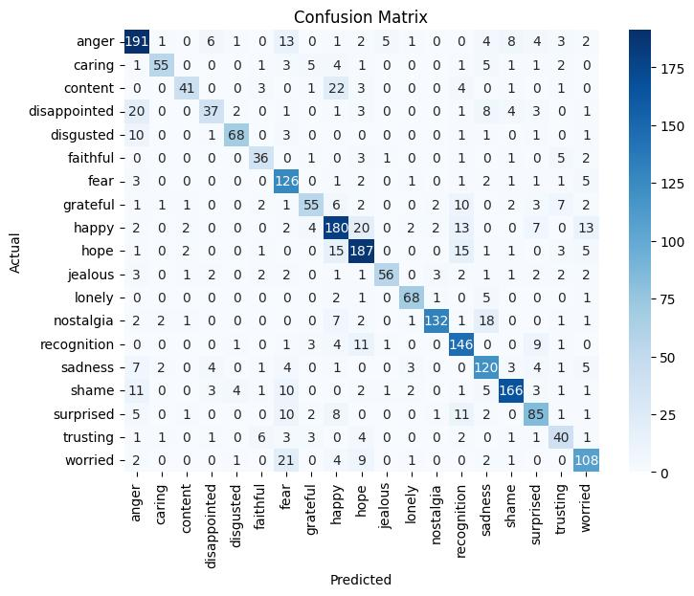
Results - Test Set

Slide 30
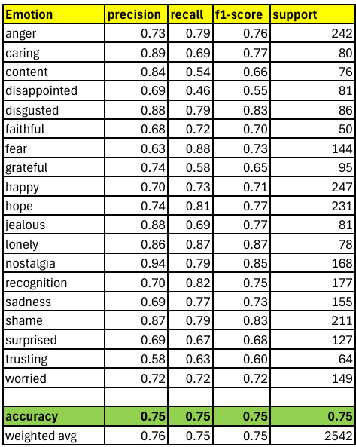
Results - Test Set

Slide 31
Results - Test Set
Example 1:
Conversation: I got attacked by a swarm of bees a few months back. Needless to say it hurt. How awful, besides painful, it must have been scary! It was, they we're absolutely furious with me for some reason. Were you messing with them, maybe? or taking their honey?
True Label: anger
Predicted Label: fear
Example 2:
Conversation: I have to rely on my prayers and my belief in a high power to get me through not having a job and no money. Things work out. It doesn't seem like it but they do. I remind myself all the time that it will work out and all will be good again. It will. I am sure of it.
True Label: faithful
Predicted Label: trusting
Example 3:
Conversation: My husband was teaching me how to make a steak. The flame was so warm! That sounds like a fun thing to do as a couple. It was but I was so sad that I was so scared Why were you so scared?
True Label: worried
Predicted Label: fear

Slide 32
Conclusion
Aspect | Traditional ML (Hierarchical Model) | Deep Learning (BERT)
Performance | Lower accuracy, F1-score | Higher accuracy, better F1-score
Feature Extraction | Requires manual feature engineering (TF-IDF) | Automatically learns from raw data
Computation | Low (works on CPU) | High (needs GPU)
Speed | Faster training | Slower training
Use case scalability | Suitable for resource-limited environments & simple tasks | Best for complex NLP where accuracy matters more than speed

Slide 33
THANK YOU!

